Slide 1
Mortgage Insurance Cross Sell
Presented BY –
Sandhyarani sahoo

Slide 2
Content
Problem Statement
Approach
Assumptions
Data Analysis
Risk Analysis
Inferences
Potential PPI Buyers
PPI Products for Different Target Segments
Conclusion – Strategy and KPI to measure Effectiveness

Slide 3
Problem Statement
A consumer bank with a range of products would like to cross-sell insurance to its consumer base. The bank wanted to decide –
Who should they target from the pool of customers that currently do not have a PPI
What type of PPI product they should be targeting them with

Slide 4
Approach
Read and Understand the Dataset
Data Preprocessing
Remove Unwanted Columns
Handle Missing Values
Handle Skewed Categorical Features
Analysis and Handling of Numerical Features
Analysis of Other Categorical Features
Analysis of Risk-related Features
Insurance Product Analysis with respect to Target Segments
Find The Right Customer
Find The Right Product
Strategy to Achieve Cross Sell
KPI to Measure The Effectiveness

Slide 5
Assumptions
Insurance Description and category is missing for those rows where the customers have not bought any PPI
Age consists of negative values, which cannot be true. Assumed it as a typo and converted it to positive values.
In CIFAS_Detected and Bankruptcy_Detected Features, assumption is 'T' might be typo for 'Y as 'T' and 'Y' are besides each other in the keyboard. Replaced 'T' with 'Y’.
Binning of Credit Score - Very Low:300-500, Low:500-700, Average:700-900, High:900-1100, Very High:1100 & Above
Binning of Term - Short Term: <2 years, Medium: 2-5 years, Long: 5+ years

Slide 6
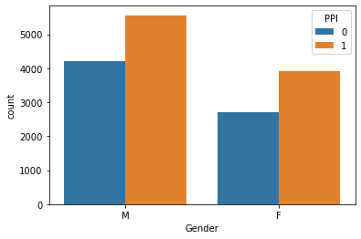
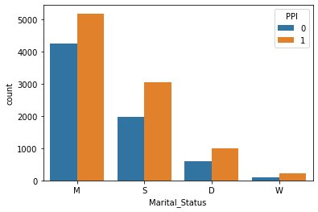
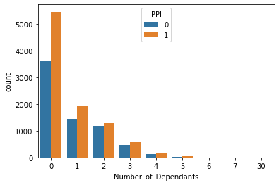
Data Analysis – Gender, Marital Status & No. of Dependents
Gender is not equally distributed. Male customers are more likely to buy PPI in comparison to Female customers.
Married customers are the most prospective PPI buyers followed by Single customers.
If the customer has less number of dependents, then the customer is more likely to buy PPI

Slide 7
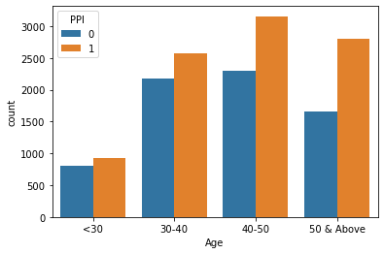
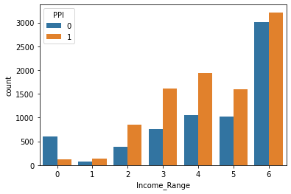
Data Analysis – Age & Income Range
Customers above the age 30 are prospective PPI buyers.
If the customer employment status is P or G, they are prospective buyers of PPI.

Slide 8
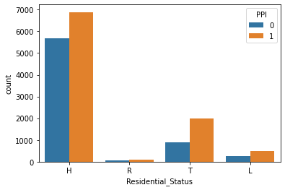
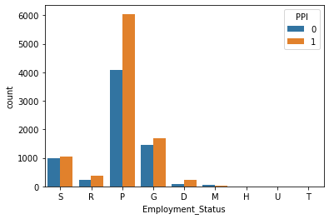
Data Analysis – Residential and Employment Status
House owners are more likely to buy PPI followed by Tenants.
If the customer employment status is P or G, they are prospective buyers of PPI.

Slide 9
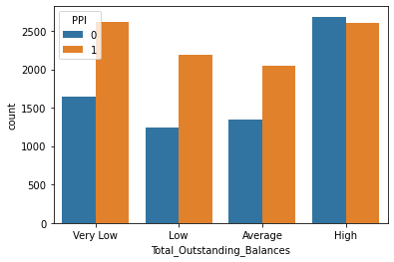
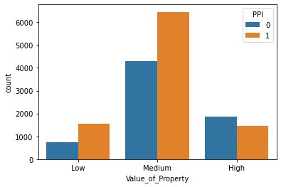
Data Analysis – Value of Property and Total Outstanding Balance
Most of the customers fall in high 'Total_Outstanding_Balances' bracket followed by 'Very Low’
Across all the buckets, customers have opted for PPI. There is not any significant differences in the PPI customers across different buckets.
When the value of the property is very high, there are less number of prospective PPI customers.

Slide 10
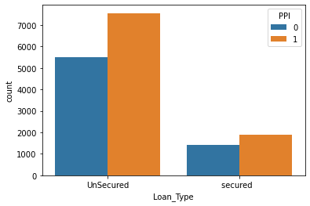
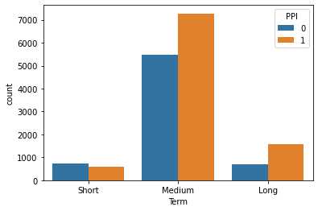
Data Analysis – Loan Type & Term
If the 'Loan_Type' is 'Unsecured', customers are more likely to buy PPI.
Most of the customers fall under 'Medium Term'.

Slide 11
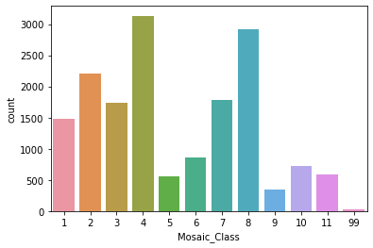
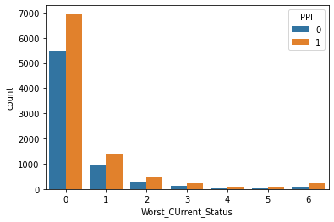
Data Analysis – Mosaic Class & Worst Current Status
Customers falling under Mosaic Class of 4 and 8 are prospective buyers of PPI.
Customers falling under Mosaic Class of 5,6,9,10,11 and 99 are least likely to buy PPI.
Worst Current status 0 & 1 are likely to buy PPI insurance

Slide 12
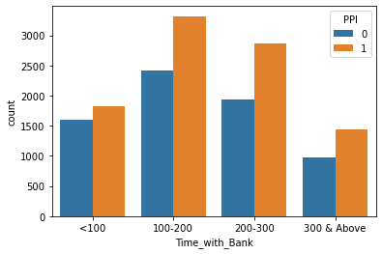
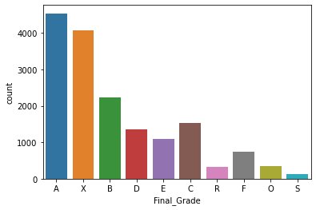
Data Analysis – Time with Bank & Final Grade
Customers who have stayed with the bank from past 100 to 300 months are more likely to buy PPI.
Customers with 'Final_Grade' values 'A' and 'X' are more likely to buy PPI.

Slide 13
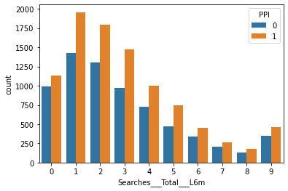
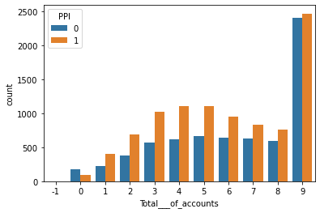
Data Analysis – Searches and Accounts
If the customer search is in 0 to 4 within last 6 months, then they are the prospects.
If a customer has 9 accounts, they are the likely PPI buyers.

Slide 14
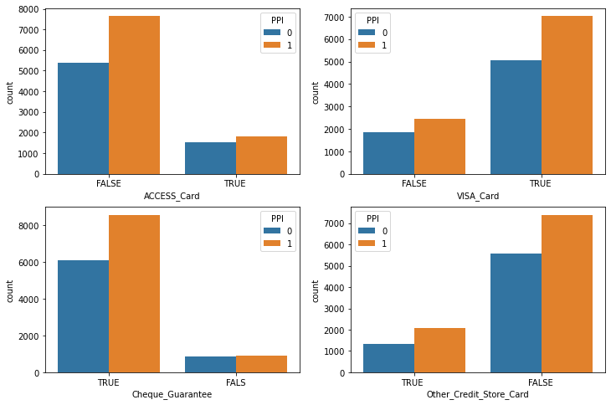
Data Analysis – Card Features
Customers using/having VISA_Card and Cheque_Guarantee are more likely to buy PPI.

Slide 15
Risk-Related Features
Features having CIFAS, CCJ, Bankruptcy are related to risk. So the bank should flag the customers falling under these buckets to the risk team for further analysis before doing any proactive selling.
Bank can sell to those customers where CIFAS_Detected or Bankruptcy_Detected__SP_ is 'N'.
Bank should flag those customers where CIFAS_Detected or Bankruptcy_Detected__SP_ is 'Y' to the risk team before any sales pitch.
13.87% of the data needs the attention of the Risk team before any sales pitch.

Slide 16
Inferences
57.7% of customers have bought PPI and 42.3% of customers have not bought PPI
Most of the customers have Average and high credit score especially in the range of 700 to 1100
Most of the customer loans fall under 'Medium Term’.
Most of the customers are likely to buy ' Single' PPI followed by 'LCI’.
The highest number of customers have bought ‘LASU’ followed by ‘Life & Critical Illn’.

Slide 17
Potential PPI Buyers
Credit_Score: 700-1100
Term: Medium – 24 to 60 Months
Mosaic Class – 4 or 8
Less no. of dependents
Time_with_Bank – 100 to 300 Months
Value_of_Property – Medium – 100000 to 200000
High Income_Range
Age > 30
Worst Current Status = 0 or 1
Last 6 Month Search = 0 to 4
Total No. of Accounts = 9,4,5
Gender: Male
Final_Grade: A or X
Residential Status: H or T
Loan Type: Unsecured
Employment Status: P or G
Marital Status: Married

Slide 18
PPI Products for Different Target Segments
Segment | Product
Age > 50, 700< Credit_Score < 1100 | Life and Critical Illness
40 < Age < 50, 700< Credit_Score < 1100 | LASU
Married, Final_Grade = A | JOINT LASCI
Widow or Divorcee, Final Grade = A or X | Life and Critical Illness or LASU
Income Range = 0 , 700< Credit_Score < 900 | Gold
Time with Bank < 200, 0<Last 6 month Search< 8 | LASU
Value of Property = Low, Outstanding Balance = Very Low | Gold
Value of Property = Low or Medium | LASU
Value of Property = High | Life and Critical Illness
Employment Status = G , Residential Status = H | Life and Critical Illness
Employment Status = G, Residential Status = T | LASU
Employment Status = P , Residential Status = H or T | LASU
Mosaic Class = 4 or 8, Worst_Current_Status = 0 or 1 | LASU or Life and Critical Illness or LASCI

Slide 19
Conclusion – Strategy and KPI to measure Effectiveness
Bank needs to start a campaign for the right target segment with the right product to achieve higher cross sell.
Cross sell Effectiveness KPI:
Percentage of Target Customers who bought the offer
Revenue Earned from New Customer - Marketing Campaign Expenses

Slide 20
THANK YOU

Slide 21
Appendix: Skewed Categorical Features
Telephone_Indicator
Full_Part_Time_Empl_Ind
Perm_Temp_Empl_Ind
Current_Account
American_Express
Diners_Card
Payment_Method

